Slide 1
TRAVELING PLANNING & TRACKING APP
MOHANA PRIYA.V
710422243032

Slide 2
DESCRIPTION
TravelPal is your ultimate travel companion!
Plan, organize, and enjoy stress-free
trips with our intuitive app. Research destinations,
book flights and hotels, track itineraries, and discover local experiences.
Key Features:
Destination Guides: Explore top attractions, restaurants, and hidden gems.
Trip Planner: Create customizable itineraries and share with fellow travelers.
Flight and Hotel Booking: Compare prices and book seamlessly.4.
Real-time Tracking: Monitor flight status, weather, and travel alerts.5
Packing List: Generate and manage essentials.
Offline Maps: Navigate destinations without internet.
Community Forum: Connect with fellow travelers and share tips.
Download TravelPal today and start exploring the world!
Would you like me to add any specific features or functionalities to this app description?Or would you like me to suggest some existing travel planning apps?

Slide 3
Main Activity.java:
package com.example.travelapp
import android.content.Context
import android.content.Intent
import android.os.Bundle
import androidx.activity.ComponentActivity
import androidx.activity.compose.setContent
import androidx.compose.foundation.Image
import androidx.compose.foundation.clickable
import androidx.compose.foundation.layout.*
import androidx.compose.foundation.rememberScrollState
import androidx.compose.foundation.verticalScroll
import androidx.compose.material.Card
import androidx.compose.material.Text
import androidx.compose.runtime.Composable
import androidx.compose.ui.Alignment
import androidx.compose.ui.Modifier
import androidx.compose.ui.draw.scale
import androidx.compose.ui.graphics.Color
import androidx.compose.ui.res.painterResource

Slide 4
import androidx.compose.ui.res.stringResource
import androidx.compose.ui.text.font.FontFamily
import androidx.compose.ui.text.font.FontWeight
import androidx.compose.ui.text.style.TextAlign
import androidx.compose.ui.unit.dp
import androidx.compose.ui.unit.sp

Slide 5
class MainActivity :
ComponentActivity() {
override fun onCreate(savedInstanceState: Bundle?) {
super.onCreate(savedInstanceState)
setContent {
TravelApp(this)
}
}
@Composable
fun TravelApp(context: Context) {
Column(
modifier = Modifier
.padding(20.dp)
.verticalScroll(rememberScrollState())
) {

Slide 6
Text(
fontSize = 40.sp,
color = Color(android.graphics.Color.rgb(120, 40, 251)),
fontFamily = FontFamily.Cursive,
text = "Wanderlust Travel"
)
Spacer(modifier = Modifier.height(20.dp))
// 01
Card(
modifier = Modifier
.fillMaxWidth()
.height(250.dp)
.clickable {
context.startActivity(
Intent(context, BaliActivity::class.java)
)
},
elevation = 8.dp
)
{

Slide 7
Column(
horizontalAlignment = Alignment.CenterHorizontally
) {
Image(
painterResource(id = R.drawable.bali), contentDescription = "",
modifier = Modifier
.height(150.dp)
.scale(scaleX = 1.2F, scaleY = 1F)
)
Text(
text = stringResource(id = R.string.place_1),
fontSize = 18.sp
)
Text(
text = stringResource(id = R.string.description),
fontWeight = FontWeight.Light,
fontSize = 16.sp,
textAlign = TextAlign.Center,
)

Slide 8
Text(
text = stringResource(id = R.string.plan), color = Color.Gray,
fontSize = 16.sp
)
}
}
Spacer(modifier = Modifier.height(20.dp))
//02
Card(
modifier = Modifier
.fillMaxWidth()
.height(250.dp)
.clickable {
context.startActivity(
Intent(context, ParisActivity::class.java)
)
},
elevation = 8.dp
)
{

Slide 9
Column(
horizontalAlignment = Alignment.CenterHorizontally
) {
Image(
painterResource(id = R.drawable.paris), contentDescription = "",
modifier = Modifier
.height(150.dp)
.scale(scaleX = 1.2F, scaleY = 1F)
)
Text(
text = stringResource(id = R.string.place_2),
fontSize = 18.sp
)
Text(

Slide 10
text = stringResource(id = R.string.description),
fontWeight = FontWeight.Light,
fontSize = 16.sp,
textAlign = TextAlign.Center,
)
Text(
text = stringResource(id = R.string.plan), color = Color.Gray,
fontSize = 16.sp
)
}
}
Spacer(modifier = Modifier.height(20.dp))
//03
Card(

Slide 11
Text(
text = stringResource(id = R.string.place_3),
fontSize = 18.sp
)
Text(
text = stringResource(id = R.string.description),
fontWeight = FontWeight.Light,
fontSize = 16.sp,
textAlign = TextAlign.Center,
)
Text(
text = stringResource(id = R.string.plan), color = Color.Gray,
fontSize = 16.sp
)
}
}
Spacer(modifier = Modifier.height(20.dp))
}
}
}

Slide 12
package com.example.travelapp
import android.content.Context
import android.content.Intent
import android.os.Bundle
import androidx.activity.ComponentActivity
import androidx.activity.compose.setContent
import androidx.compose.foundation.Image
import androidx.compose.foundation.background
import androidx.compose.foundation.layout.*
import androidx.compose.material.*
import androidx.compose.runtime.*
import androidx.compose.ui.Alignment
import androidx.compose.ui.Modifier
import androidx.compose.ui.graphics.Color
import androidx.compose.ui.layout.ContentScale
import androidx.compose.ui.res.painterResource
import androidx.compose.ui.text.font.FontFamily
import androidx.compose.ui.text.font.FontWeight
import androidx.compose.ui.text.input.PasswordVisualTransformation
import androidx.compose.ui.tooling.preview.Preview
import androidx.compose.ui.unit.dp
import androidx.compose.ui.unit.sp
import androidx.core.content.ContextCompat

Slide 13
class LoginActivity : ComponentActivity() {
private lateinit var databaseHelper: UserDatabaseHelper
override fun onCreate(savedInstanceState: Bundle?) {
super.onCreate(savedInstanceState)
databaseHelper = UserDatabaseHelper(this)
setContent {
LoginScreen(this, databaseHelper)
}
}
}
@Composable
fun LoginScreen(context: Context, databaseHelper: UserDatabaseHelper) {
var username by remember { mutableStateOf("") }
var password by remember { mutableStateOf("") }
var error by remember { mutableStateOf("") }
Column(
modifier = Modifier.fillMaxSize().background(Color.White),
horizontalAlignment = Alignment.CenterHorizontally,
verticalArrangement = Arrangement.Center
) {
Image(painterResource(id = R.drawable.trav), contentDescription = "")

Slide 14
Text(
fontSize = 36.sp,
fontWeight = FontWeight.ExtraBold,
fontFamily = FontFamily.Cursive,
text = "Login"
)
Spacer(modifier = Modifier.height(10.dp))
TextField(
value = username,
onValueChange = { username = it },
label = { Text("Username") },
modifier = Modifier.padding(10.dp)
.width(280.dp)
)
TextField(
value = password,
onValueChange = { password = it },
label = { Text("Password") },
visualTransformation = PasswordVisualTransformation(),
modifier = Modifier.padding(10.dp)
.width(280.dp)
)

Slide 15
if (error.isNotEmpty()) {
Text(
text = error,
color = MaterialTheme.colors.error,
modifier = Modifier.padding(vertical = 16.dp)
)
}
Button(
onClick = {
if (username.isNotEmpty() && password.isNotEmpty()) {
val user = databaseHelper.getUserByUsername(username)
if (user != null && user.password == password) {
error = "Successfully log in"
context.startActivity(
Intent(
context,
MainActivity::class.java
)
)
//onLoginSuccess()
}

Slide 16
else {
error = "Invalid username or password"
}
} else {
error = "Please fill all fields"
}
},
modifier = Modifier.padding(top = 16.dp)
) {
Text(text = "Login")
}
Row {
TextButton(onClick = {context.startActivity(
Intent(
context,
RegisterActivity::class.java
)
)}
)

Slide 17
{ Text(text = "Register") }
TextButton(onClick = {
})
{
Spacer(modifier = Modifier.width(60.dp))
Text(text = "Forget password?")
}
}
}
}
private fun startMainPage(context: Context) {
val intent = Intent(context, MainActivity::class.java)
ContextCompat.startActivity(context, intent, null)
}

Slide 18
import android.os.Bundle
import androidx.activity.ComponentActivity
import androidx.activity.compose.setContent
import androidx.compose.foundation.Image
import androidx.compose.foundation.background
import androidx.compose.foundation.layout.*
import androidx.compose.foundation.rememberScrollState
import androidx.compose.foundation.verticalScroll
import androidx.compose.material.MaterialTheme
import androidx.compose.material.Surface
import androidx.compose.material.Text
import androidx.compose.runtime.Composable
import androidx.compose.ui.Modifier
import androidx.compose.ui.draw.scale
import androidx.compose.ui.graphics.Color
import androidx.compose.ui.res.painterResource
import androidx.compose.ui.res.stringResource
import androidx.compose.ui.text.font.FontFamily
import androidx.compose.ui.tooling.preview.Preview
import androidx.compose.ui.unit.dp
import androidx.compose.ui.unit.sp
import com.example.travelapp.ui.theme.TravelAppTheme

Slide 19
class ParisActivity : ComponentActivity() {
override fun onCreate(savedInstanceState: Bundle?) {
super.onCreate(savedInstanceState)
setContent {
TravelAppTheme {
// A surface container using the 'background' color from the theme
Surface(
modifier = Modifier.fillMaxSize(),
color = MaterialTheme.colors.background
) {
Greeting()
}
}
}
}
}

Slide 20
@Composable
fun Greeting() {
Column(
modifier = Modifier.background(color = Color.White)
.padding(20.dp)
.verticalScroll(rememberScrollState())
) {
Text(
fontSize = 40.sp,
color = Color(android.graphics.Color.rgb(120, 40, 251)),
fontFamily = FontFamily.Cursive,
text = stringResource(id = R.string.place_2),
)
Image(
painterResource(id = R.drawable.paris), contentDescription = "",
modifier = Modifier
.padding(16.dp)
.fillMaxWidth()
.height(200.dp)
.scale(scaleX = 1.2F, scaleY = 1F)
)

Slide 21
Text(
color=Color.Black,
text = "Day 1: Arrival and Introduction\n" +
"Check into your accommodation and freshen up\n" +
"Take a stroll around the neighborhood to get acquainted\n" +
"Visit the Eiffel Tower, preferably in the evening when it is lit up\n" +
"Have a relaxing dinner at a nearby restaurant\n" +
"\n" +
"Day 2: Art and History\n" +
"Visit the Louvre Museum to see some of the world's most famous art pieces\n" +
"Stroll through the Tuileries Garden and the Place de la Concorde\n" +
"Visit the Orsay Museum, which houses a large collection of impressionist art\n" +
"Have dinner at a local French restaurant\n" +
"\n" +
"Day 3: French Culture and Food\n" +
"Visit the Montmartre neighborhood to see the famous Basilique du Sacré-Cœur and Place du Tertre\n" +
"Explore the historic neighborhood of Le Marais\n" +
"Try some delicious French pastries at a local bakery\n" +
"Have dinner at a brasserie to taste some classic French cuisine\n" +
"\n" +

Slide 22
"Day 4: Architecture and Gardens\n" +
"Visit the Palace of Versailles, a UNESCO World Heritage site, and explore its beautiful gardens\n" +
"Walk along the Champs-Elysées and stop at the Arc de Triomphe\n" +
"Visit the Sainte-Chapelle, a beautiful Gothic chapel with stunning stained-glass windows\n" +
"Have dinner at a local restaurant in the 7th arrondissement\n" +
"\n" +
"Day 5: Shopping and Sightseeing\n" +
"Visit the Notre-Dame Cathedral and climb up to the top for a stunning view of the city\n" +
"Explore the Latin Quarter and visit the Panthéon\n" +
"Go shopping at the famous Galeries Lafayette or Printemps department stores\n" +
"Have dinner at a local bistro\n" +
"\n" +
"Day 6: Parisian Parks and Museums\n" +
"Visit the Musée Rodin and explore its beautiful gardens\n" +
"Stroll through the Luxembourg Gardens and visit the Luxembourg Palace\n" +
"Visit the Centre Pompidou, a modern art museum in the Marais neighborhood\n" +
"Have dinner at a local restaurant in the Latin Quarter\n" +
"\n" +

Slide 23
"Day 7: River Cruise and Farewell\n" +
"Take a boat cruise along the Seine River to see the city from a different perspective\n" +
"Visit the Musée de l'Orangerie, which houses Monet's famous water lilies paintings\n" +
"Have a farewell dinner at a Michelin-starred restaurant"
)
}
}

Slide 24
import android.content.Context
import android.content.Intent
import android.os.Bundle
import androidx.activity.ComponentActivity
import androidx.activity.compose.setContent
import androidx.compose.foundation.Image
import androidx.compose.foundation.background
import androidx.compose.foundation.layout.*
import androidx.compose.material.*
import androidx.compose.runtime.*
import androidx.compose.ui.Alignment
import androidx.compose.ui.Modifier
import androidx.compose.ui.graphics.Color
import androidx.compose.ui.layout.ContentScale
import androidx.compose.ui.res.painterResource
import androidx.compose.ui.text.font.FontFamily
import androidx.compose.ui.text.font.FontWeight
import androidx.compose.ui.text.input.PasswordVisualTransformation
import androidx.compose.ui.tooling.preview.Preview
import androidx.compose.ui.unit.dp
import androidx.compose.ui.unit.sp
import androidx.core.content.ContextCompat

Slide 25
class RegisterActivity : ComponentActivity() {
private lateinit var databaseHelper: UserDatabaseHelper
override fun onCreate(savedInstanceState: Bundle?) {
super.onCreate(savedInstanceState)
databaseHelper = UserDatabaseHelper(this)
setContent {
RegistrationScreen(this, databaseHelper)
}
}
}
@Composable
fun RegistrationScreen(context: Context, databaseHelper: UserDatabaseHelper) {
var username by remember { mutableStateOf("") }
var password by remember { mutableStateOf("") }
var email by remember { mutableStateOf("") }
var error by remember { mutableStateOf("") }

Slide 26
Column(
modifier = Modifier.fillMaxSize().background(Color.White),
horizontalAlignment = Alignment.CenterHorizontally,
verticalArrangement = Arrangement.Center
) {
Image(painterResource(id = R.drawable.tra), contentDescription = "")
Text(
fontSize = 36.sp,
fontWeight = FontWeight.ExtraBold,
fontFamily = FontFamily.Cursive,
text = "Register"
)
Spacer(modifier = Modifier.height(10.dp))
TextField(
value = username,
onValueChange = { username = it },
label = { Text("Username") },
modifier = Modifier
.padding(10.dp)
.width(280.dp)
)

Slide 27
TextField(
value = email,
onValueChange = { email = it },
label = { Text("Email") },
modifier = Modifier
.padding(10.dp)
.width(280.dp)
)
TextField(
value = password,
onValueChange = { password = it },
label = { Text("Password") },
visualTransformation = PasswordVisualTransformation(),
modifier = Modifier
.padding(10.dp)
.width(280.dp)
)

Slide 28
if (error.isNotEmpty()) {
Text(
text = error,
color = MaterialTheme.colors.error,
modifier = Modifier.padding(vertical = 16.dp)
)
}
Button(
onClick = {
if (username.isNotEmpty() && password.isNotEmpty() && email.isNotEmpty()) {
val user = User(
id = null,
firstName = username,
lastName = null,
email = email,
password = password
)

Slide 29
databaseHelper.insertUser(user)
error = "User registered successfully"
// Start LoginActivity using the current context
context.startActivity(
Intent(
context,
LoginActivity::class.java
)
)
} else {
error = "Please fill all fields"
}
},
modifier = Modifier.padding(top = 16.dp)
) {
Text(text = "Register")
}

Slide 30
Spacer(modifier = Modifier.width(10.dp))
Spacer(modifier = Modifier.height(10.dp))
Row() {
Text(
modifier = Modifier.padding(top = 14.dp), text = "Have an account?"
)
TextButton(onClick = {
context.startActivity(
Intent(
context,
LoginActivity::class.java
)
)
})
{
Spacer(modifier = Modifier.width(10.dp))
Text(text = "Log in")
}
}
}
}

Slide 31
private fun startLoginActivity(context: Context) {
val intent = Intent(context, LoginActivity::class.java)
ContextCompat.startActivity(context, intent, null)
}

Slide 32
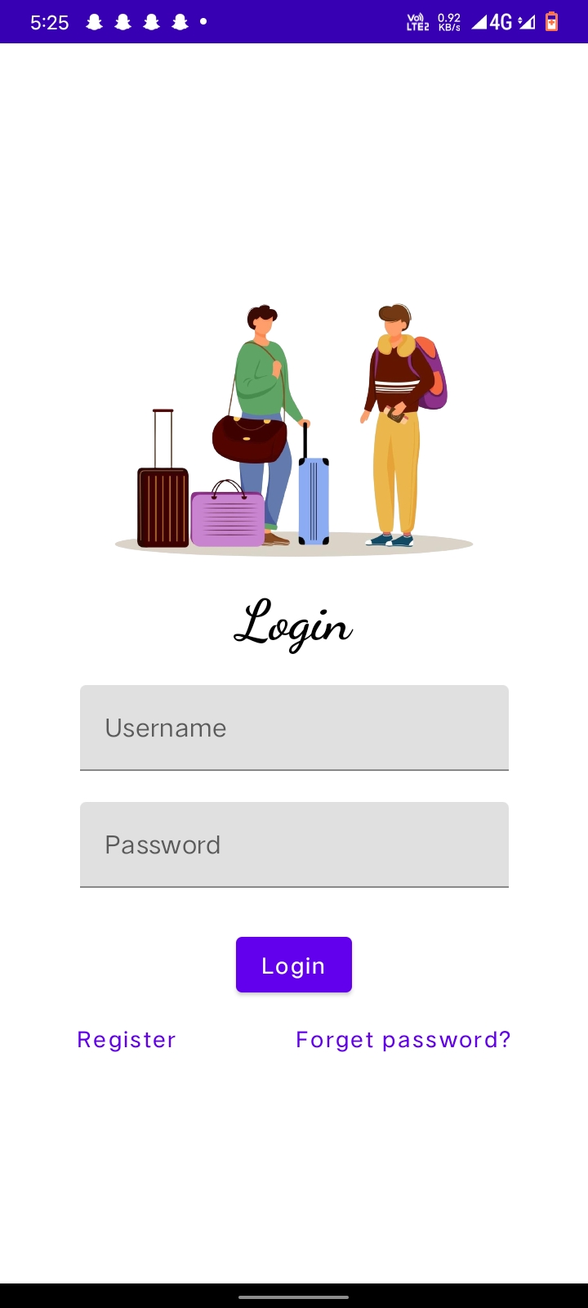
OUTPUT:

Slide 33
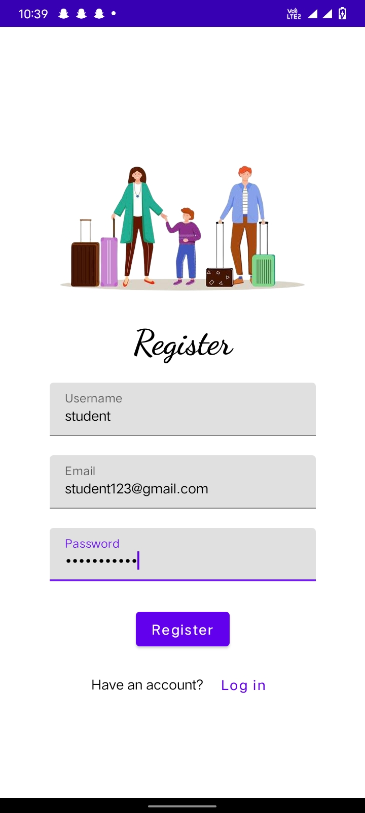

Slide 34
